Slide 1
Troubleshooting Functions
W. Clements
CSE 111 Program with Functions

Slide 2
Overview
Prepare: Reading, Video
Checkpoint Debug, Debugger
Teach: Class Activity
Prove: Milestone sentences and unit testing
Ponder: Check your understanding

Slide 3
Schedule Due Dates
Week | Monday | Tuesday | Wednesday | Thursday | Friday | Saturday
1 10/26 |  |  | Prepare 01 |  | Ice Breaker 01 Ponder | 01 Milestone 02 Prepare
2 10/31 | L02 Checkpoint L03 Prepare | L02 Teach L02 Ponder | L02 Prove L03 Checkpoint | L03 Teach | L03 Ponder | L03 Milestone L04 Prepare
3 11/07 | L04 Checkpoint L05 Prepare | L04 Teach L04 Ponder | L04 Prove L05 Checkpoint | L05 Teach | L05 Ponder | L05 Milestone L06 Prepare
4 11/14 | L06 Checkpoint L07 Prepare | L06 Teach L06 Ponder | L06 Prove L07 Checkpoint | L07 Teach | L07 Ponder | L07 Milestone L08 Prepare
5 11/21 | L08 Checkpoint L09 Prepare | L08 Teach L08 Ponder | Thanksgiving Break |  |  | L08 Prove L10 Prepare
6 11/28 | L09 Checkpoint L10 Prepare | L09 Teach L09 Ponder | L09 Milestone L10 Checkpoint | L10 Teach | L10 Ponder | L10 Prove L11 Prepare
7 12/05 | L11 Checkpoint L12 Prepare | L11 Teach L11 Ponder | L11 Milestone L12 Checkpoint | L12 Teach | L12 Ponder | L12 Prove L14 Prepare
8 12/12 | L14 Prepare | L13 Ponder | L13 Prove L14 Prove

Slide 4
06 Prepare: Troubleshooting Functions
Concepts¶
Types of Mistakes¶
Error Messages
Print Statements¶
Test Functions
Using a Debugger¶
Summary¶

Slide 5
Types of Mistakes¶
Types Tools Messages
Syntax Compiler on line number, … error
Logic Test pytest; test_functions(): assert
Runtime ?
Debugging Print
Debugger

Slide 6
Print/Debug
Instead of adding a bunch of print statements,
Create a debug function,
Use debug instead of print
debug_flag = True
#debug_flag = False
def debug (debug_string):
if (debug_flag):
print(debug_string)

Slide 7
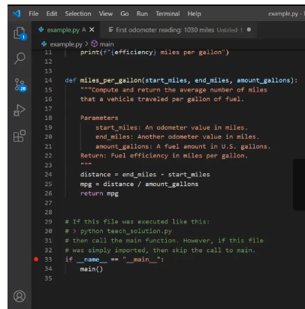
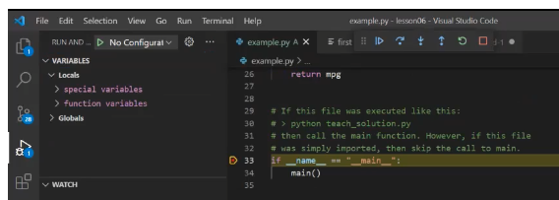
Debugger
Using the VS Code Debugger
Breakpoints
Visibles
Variables
Watch
Call Stack
Actions
|> Continue
.( Step over
\/ Step into
/\ Step out
@ Restart
[] Stop

Slide 8
06 Checkpoint: Troubleshooting Functions
https://byui-cse.github.io/cse111-course/lesson06/teach.html

Slide 9
06 Checkpoint: Troubleshooting Functions
Purpose
Assignment
Practice using the Python debugger in VS Code.
Do the following:
Download and save the example.py file.
Open example.py in VS Code.
Follow along with this video about the Python Debugger (17 minutes) from the prepare content and use the debugger in VS Code to step through the example.py program.
https://byui-cse.github.io/cse111-course/lesson06/teach.html

Slide 10
06 Checkpoint: Troubleshooting Functions
Poinder¶
As you used the debugger to step through the example.py program, did you learn anything new about Python and how functions work? Do you think the debugger could help you find mistakes in your code?
https://byui-cse.github.io/cse111-course/lesson06/teach.html

Slide 11
06 Team Activity: Troubleshooting Functions
https://byui-cse.github.io/cse111-course/lesson06/teach.html

Slide 12
06 Team Activity: Troubleshooting Functions
Purpose
Write a program with several functions. Use a debugger while writing your program or after writing it to step through your code..
https://byui-cse.github.io/cse111-course/lesson06/teach.html

Slide 13
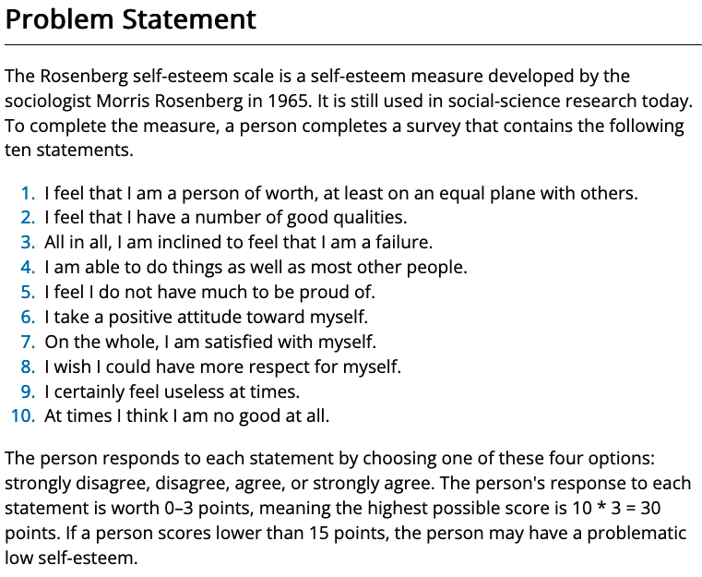
06 Team Activity: Troubleshooting Functions
Purpose
Writing and running test functions often help a software developer find mistakes in code.
During this assignment, you will write three test functions.
Then use pytest to run the test functions and use the output of pytest to help you find and fix errors in some program functions.
https://byui-cse.github.io/cse111-course/lesson06/teach.html

Slide 14
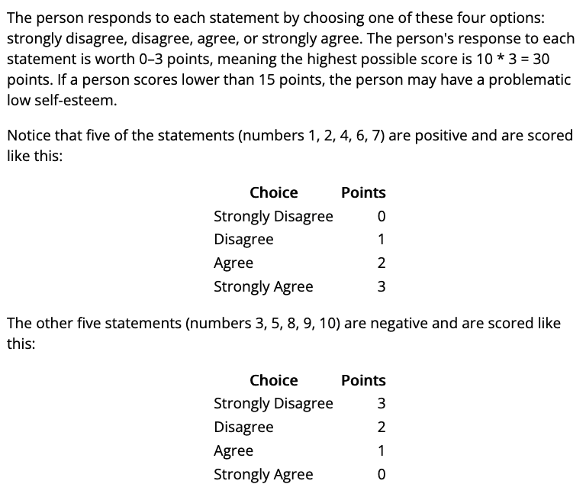
06 Team Activity: Troubleshooting Functions
Purpose
Writing and running test functions often help a software developer find mistakes in code.
During this assignment, you will write three test functions.
Then use pytest to run the test functions and use the output of pytest to help you find and fix errors in some program functions.
https://byui-cse.github.io/cse111-course/lesson06/teach.html

Slide 15
06 Team Activity: Troubleshooting Functions
Assignment
Core Requirements¶
As a team, write a Python program named esteem.py that implements the Rosenberg self-esteem scale.
Your program must ask the user to respond to each of the ten statements with D, d, a, or A which mean strongly disagree, disagree, agree, and strongly agree.
Your program must compute the score for each answer and sum and display the person's total score.
You should think about how you will separate this program into functions before you begin writing the program.
Your program prints the introductory text as shown in the Testing Procedure section below.
Your program prints each of the ten statements and gets a response from the user.
Your program computes the score for each response and sums all the scores and displays the total score.
https://byui-cse.github.io/cse111-course/lesson06/teach.html

Slide 16
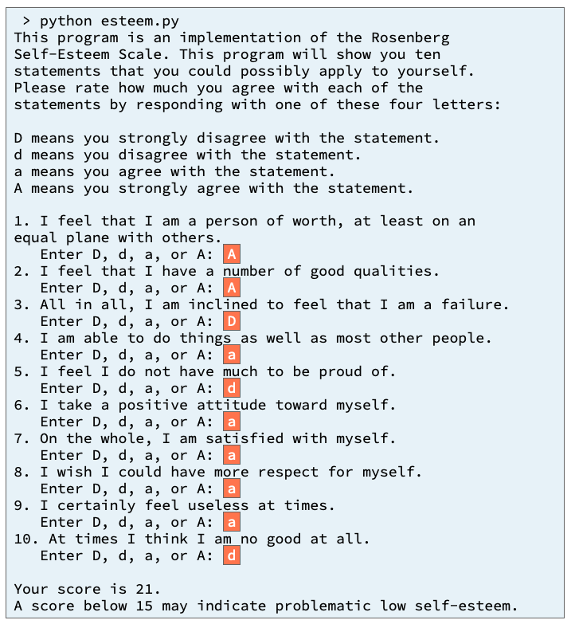
Input/Output
What do we need
What are the inputs?
What are the outputs?
https://byui-cse.github.io/cse111-course/lesson06/teach.html

Slide 17
Input/Output
What is this?
What do we need
What is this?
What are the inputs?
What are the outputs?
What is this?
https://byui-cse.github.io/cse111-course/lesson06/teach.html

Slide 18
Input/Output
What is this?
Introduction()
What do we need
What is this?
What are the inputs?
What are the outputs?
Question1()
Question2()
Question3()
…
Or
get_answers(question_list)
Return list of answers.
Compute_score() Magic happens here ===➔
What is this?
Display_results(score)
https://byui-cse.github.io/cse111-course/lesson06/teach.html

Slide 19
06 Team Activity: Troubleshooting Functions
Input
Process
Output
main
create_questsion()
Display_introduction()
Question_list
Display_score()
Get_answers()
Calculate_score()
https://byui-cse.github.io/cse111-course/lesson06/teach.html

Slide 21
06 Prove Assignment: Troubleshooting Functions
https://byui-cse.github.io/cse111-course/lesson06/prove.html

Slide 22
06 Prove Assignment: Troubleshooting Functions
Purpose
Prove that you can write a Python program and write and run test functions to help you find and fix mistakes in your program.
https://byui-cse.github.io/cse111-course/lesson06/prove.html

Slide 23
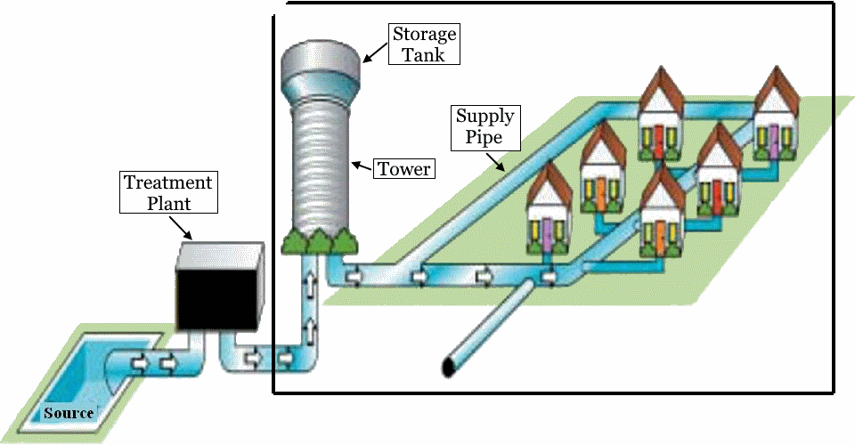
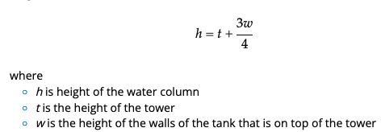
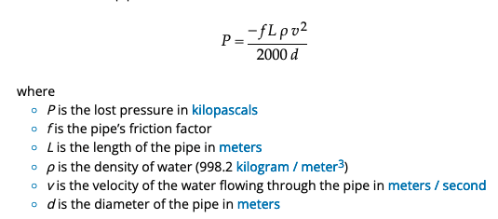
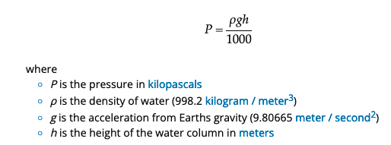
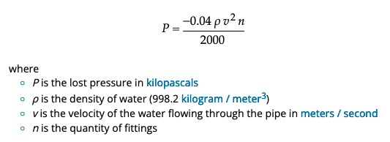
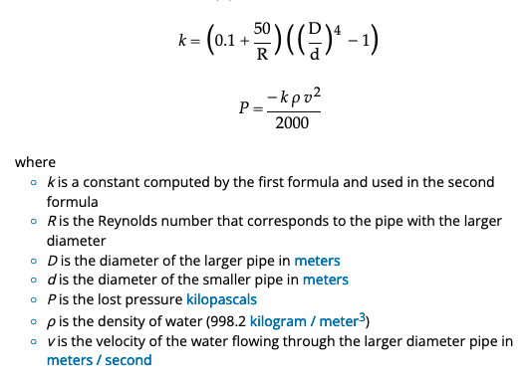
Design
water_height= water_column_height()
tank_height
Supply_loss = pressure_loss_from_pipe
tower_height
House_loss = pressure_loss_from_pipe
Tank_pressure = pressure_gain_from_water_height()
Fitting_loss = pressure_loss_from_fittings()
Reduction_loss = pressure_loss_from_pipe_reduction
Pressure = Tank_pressure + Supply_loss + Fitting_loss + Reduction_loss + House_loss

Slide 24
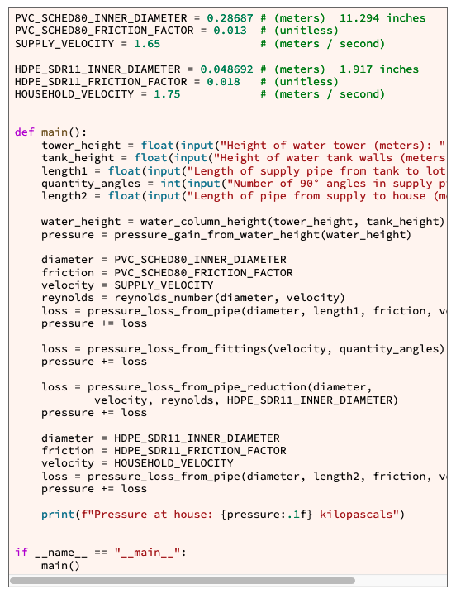
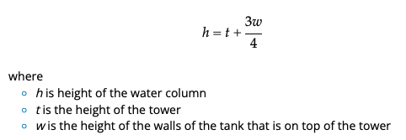
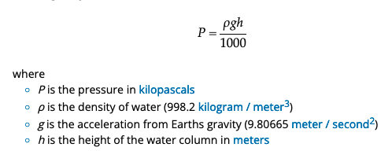
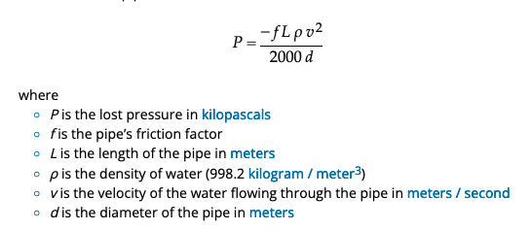
Week 05 Previous Work
Pressure =
Tank_pressure +
Supply_loss +
Fitting_loss +
Reduction_loss +
House_loss
Input
Process
Output
water_flow.py: main
Step 1
Given in Module 6, not used right now
We are only testing these functions first
Using pytest.
pipe_diameter
pipe_length
Tower_height
friction_factor
Step 2
Tank_height
Step 5
height
Step 7
fluid_velocity
water_column_height()
pressure_gain_from_water_height()
pressure_loss_from_pipe()

Slide 25
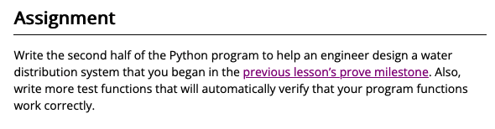
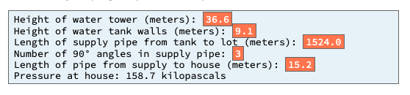
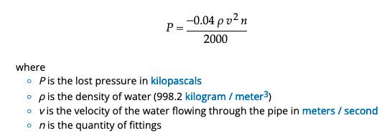
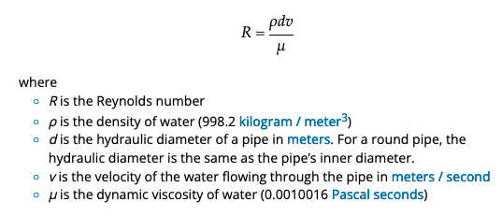
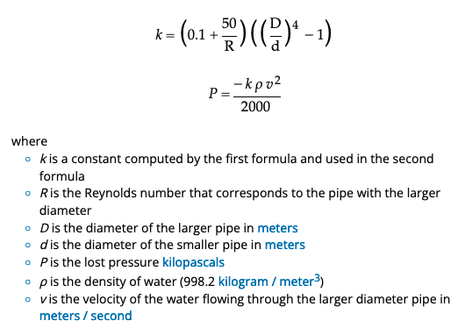
Input
Process
Output
water_flow.py: main
pipe_diameter
pipe_length
Tower_height
friction_factor
Tank_height
height
fluid_velocity
water_column_height()
pressure_gain_from_water_height()
pressure_loss_from_pipe_reduction()
larger_diameter
fluid_velocity
hydraulic_diameter
fluid_velocity
quantity_fitting
fluid_velocity
reynolds_number
pressure_loss_from_fittings()
reynolds_number()
smaller_diameter
pressure_loss_from_pipe_reduction()
https://byui-cse.github.io/cse111-course/lesson06/prove.html

Slide 26
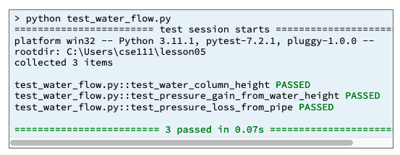
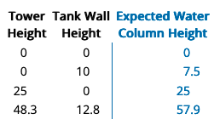
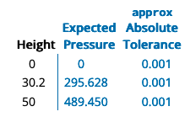
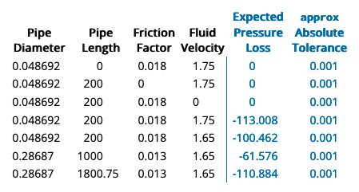
Example:
assert pressure_loss_from_fittings(1.75, 5) \
== approx(-0.306, abs=0.001)Copy code to the clipboard
Week 05 Previous Work
Input
Process
Output
water_flow.py: main
Step 3
from pytest
import approx import pytest
…
# Call the main function that is part of pytest so that the
# computer will execute the test functions in this file.
pytest.main(["-v", "--tb=line", "-rN", __file__])
Step 9
Step 4
test_water_column_height()
test_pressure_gain_from_water_height()
test_pressure_loss_from_pipe()
Step 6
Step 8
water_flow.py: main
water_column_height()
pressure_gain_from_water_height()
pressure_loss_from_pipe()

Slide 27
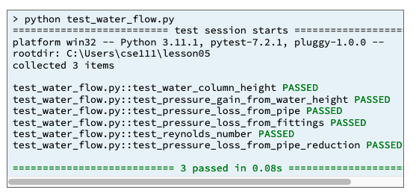
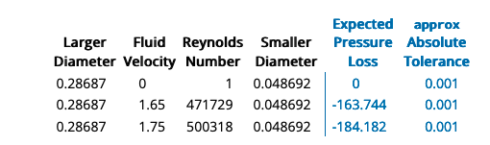
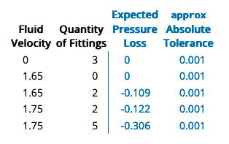
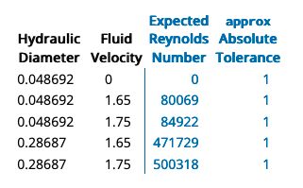
Example:
assert pressure_loss_from_fittings(1.75, 5) \
== approx(-0.306, abs=0.001)Copy code to the clipboard
Input
Process
Output
water_flow.py: main
from pytest
import approx import pytest
…
# Call the main function that is part of pytest so that the
# computer will execute the test functions in this file.
pytest.main(["-v", "--tb=line", "-rN", __file__])
test_pressure_loss_from_pipe_reduction()
test_water_column_height()
test_pressure_loss_from_fittings()
test_pressure_gain_from_water_height()
test_reynolds_number()
test_pressure_loss_from_pipe()
water_flow.py: main
water_column_height()
pressure_loss_from_fittings()
pressure_gain_from_water_height()
reynolds_number()
pressure_loss_from_pipe()
pressure_loss_from_pipe_reduction()

Slide 28
Pressure =
Tank_pressure +
Supply_loss +
Fitting_loss +
Reduction_loss +
House_loss
Constant (not variables)
PVC_SCHED80_INNER_DIAMETER = 0.28687
PVC_SCHED80_FRICTION_FACTOR = 0.013
SUPPLY_VELOCITY = 1.65
HDPE_SDR11_INNER_DIAMETER = 0.048692
HDPE_SDR11_FRICTION_FACTOR = 0.018
HOUSEHOLD_VELOCITY = 1.75
Input
Process
Output
water_flow.py: main
Print_total_pressure()
Get_tower_height()
tower_height
diameter
Get_tank_height()
tank_height
friction
pressure
pipe_diameter
Length1tank2lot
velocity
Get_length1tank2lot()
reynolds
pipe_length
quantity_angles
Get_quantity_angles()
length2supply2house
water_height
friction_factor
loss
fluid_velocity
Get_lenthsupply2house()
pressure_loss_from_pipe_reduction()
Tower_height
Tank_height
water_column_height()
fluid_velocity
height
quantity_fitting
pressure_gain_from_water_height()
pressure_loss_from_fittings()
pipe_diameter
pipe_length
hydraulic_diameter
friction_factor
fluid_velocity
fluid_velocity
reynolds_number()
pressure_loss_from_pipe()

Slide 29
Design
water_height= water_column_height()
tank_height
Supply_loss = pressure_loss_from_pipe
tower_height
House_loss = pressure_loss_from_pipe
Tank_pressure = pressure_gain_from_water_height()
Fitting_loss = pressure_loss_from_fittings()
Reduction_loss = pressure_loss_from_pipe_reduction
Pressure = Tank_pressure + Supply_loss + Fitting_loss + Reduction_loss + House_loss

Slide 30
Code Review
This is hard coded values for
Specific types of pipes. Usability would put it in a file.
And then, read it from the file and store it in a dictionary/list.
Design
Pressure =
Tank_pressure +
Supply_loss +
Fitting_loss +
Reduction_loss +
House_loss
Good practice to capture all the user input at the beginning. Follows Input->Process->Output pattern
In the future these should be functions.
Based on the design, this is the tank pressure.
Ether write a function to calculate tank_pressure, or put in comments
Based on the design, this is supply_loss.
Readability: Reynolds number is not used here. Should be called near its use.
Ether write a function to calculate supply_loss or put in comments.
Based on the design, this is the fitting_loss.
Ether write a function to calculate fitting_loss, or put in comments
Based on the design, this is the reduction_loss.
This is where Reynolds value should be calc. Ether write a function to calculate fitting_loss, or put in comments
Based on the design, this is the house_loss.
Ether write a function to calculate house_loss, or put in comments
Good practice to capture all the user ouput at the end. Follows Input->Process->Output pattern
In the future these should be functions.

Slide 31
Pressure =
Tank_pressure +
Supply_loss +
Fitting_loss +
Reduction_loss +
House_loss
Input
Process
Output
Input
Get_tower_height()
house_flow.py: main
Get_tank_height()
tower_height
Pressure =
Tank_pressure +
Supply_loss +
Fitting_loss +
Reduction_loss +
House_loss
Print_total_pressure()
tank_height
Get_length1tank2lot()
Length1tank2lot
Get_quantity_angles()
quantity_angles
Get_lenthsupply2house()
length2supply2house
Get_supply_type()
Calc_tank_pressure()
Get_house_type()
Calc_supply_loss()
file
dictionary
Calc_fiting_loss()
PVC_SCHED80_INNER_DIAMETER = 0.28687
PVC_SCHED80_FRICTION_FACTOR = 0.013
PVC_SCHED80_SUPPLY_VELOCITY = 1.65
HDPE_SDR11_INNER_DIAMETER = 0.048692
HDPE_SDR11_FRICTION_FACTOR = 0.018
HDPE_SDR11_HOUSEHOLD_VELOCITY = 1.75
SUPPLY_INNER_DIAMETER =PVC_SCHED80_INNER_DIAMETER
SUPPLY_FRICTION_FACTOR = PVC_SCHED80_FRICTION_FACTOR
SUPPLY_VELOCITY = PVC_SCHED80_SUPPLY_VELOCITY
HOUSEHOLD_INNER_DIAMETER = HDPE_SDR11_INNER_DIAMETER
HOUSEHOLD_FRICTION_FACTOR = HDPE_SDR11_FRICTION_FACTOR
HOUSEHOLD_VELOCITY = HDPE_SDR11_HOUSEHOLD_VELOCITY
Calc_reduction_loss()
Calc_house_loss()
water_flow.py: main
water_column_height()
pressure_loss_from_fittings()
pressure_gain_from_water_height()
reynolds_number()
pressure_loss_from_pipe()
pressure_loss_from_pipe_reduction()

